Slide 1
Smart Home Automated Security System
CEIS101 Final Course Project
September 2024
Anita Woods
Prof. LaQuata Sumter

Slide 2
Smart Home Automated Security System
This course project covers the fundamental concept of the IoT by integrating hardware, software, and networks into an entire system. The project is divided into six parts where each part builds upon the previous resulting in an IoT device that will simulate a smart home automation and security system. The design and development process of this project truly encompasses various aspects of the IoT and will prepare you for your future career in technology.
The objective is to introduce simulation using a virtual emulator, to familiarize with hardware components required to build physical system, to familiarize with programming logic and design of hardware, to familiarize with error handling principles in operating systems
The primary tools used for this project were PowerPoint and Tinkercad.

Slide 3
CEIS101
Module 2
Circuit Simulation in Tinkercad

Slide 4
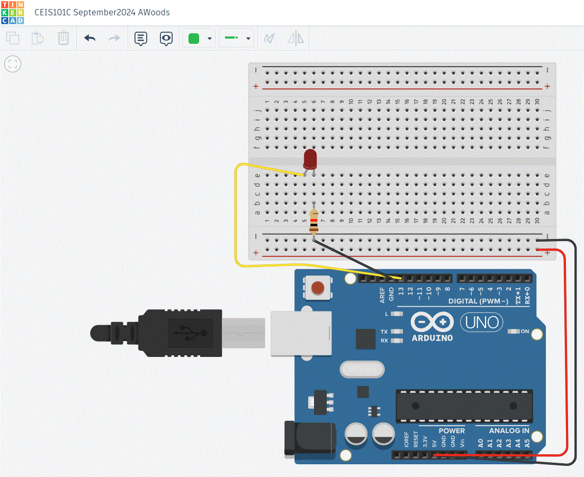
Circuit (screenshot)

Slide 5
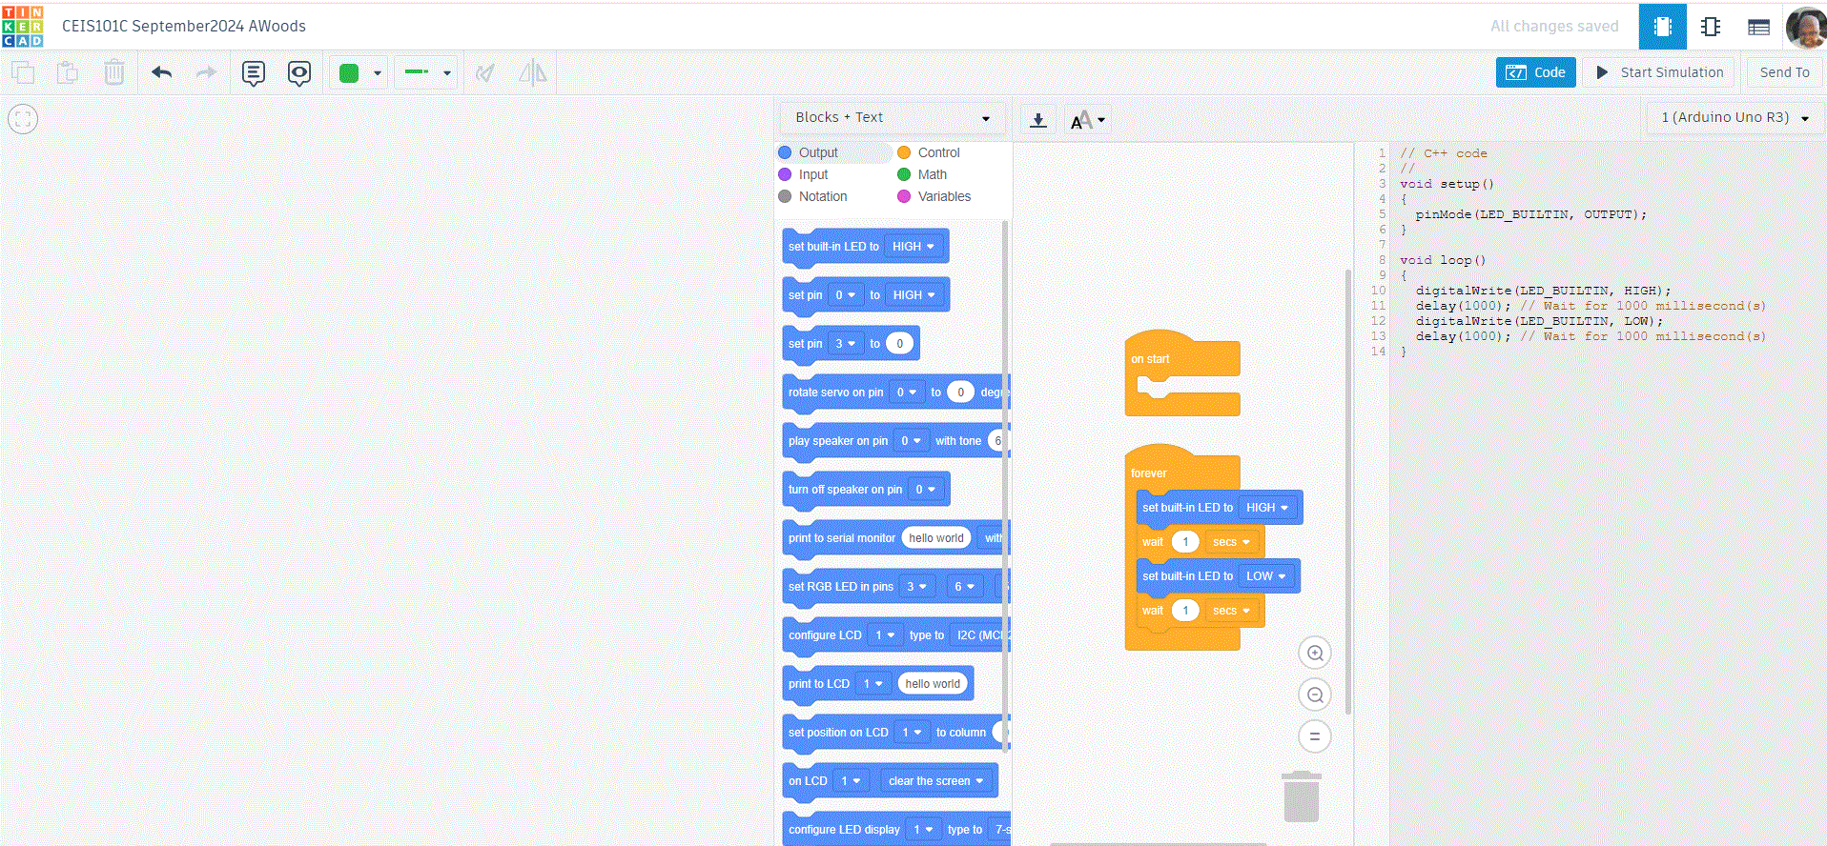
Code (screenshot)

Slide 6
CEIS101
Module 3
Inventory of Parts, Circuit Building, and Displaying Messages

Slide 7
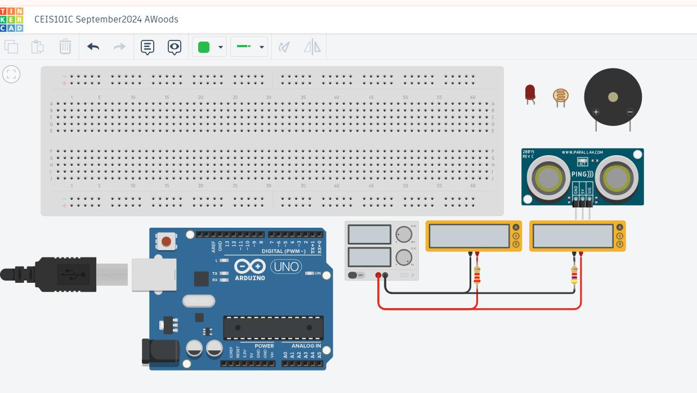
Organization of Project Components (picture)
Arduino Uno
Breadboard
Resistor 10kΩ
LEDs
Ultrasonic Sensor
Piezo
Photoresistor

Slide 8
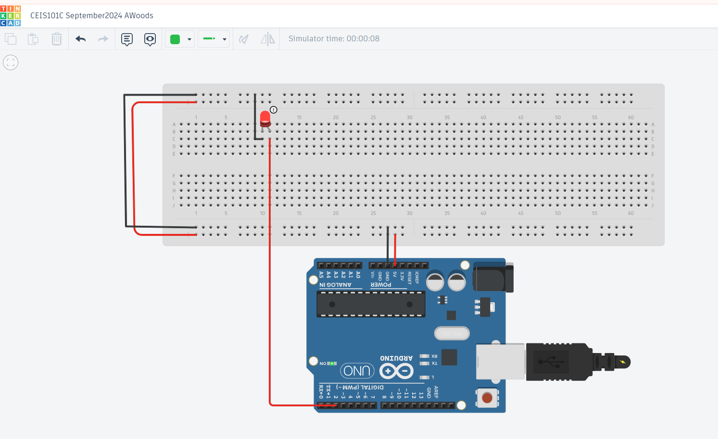
Circuit with red LED on (picture)

Slide 9
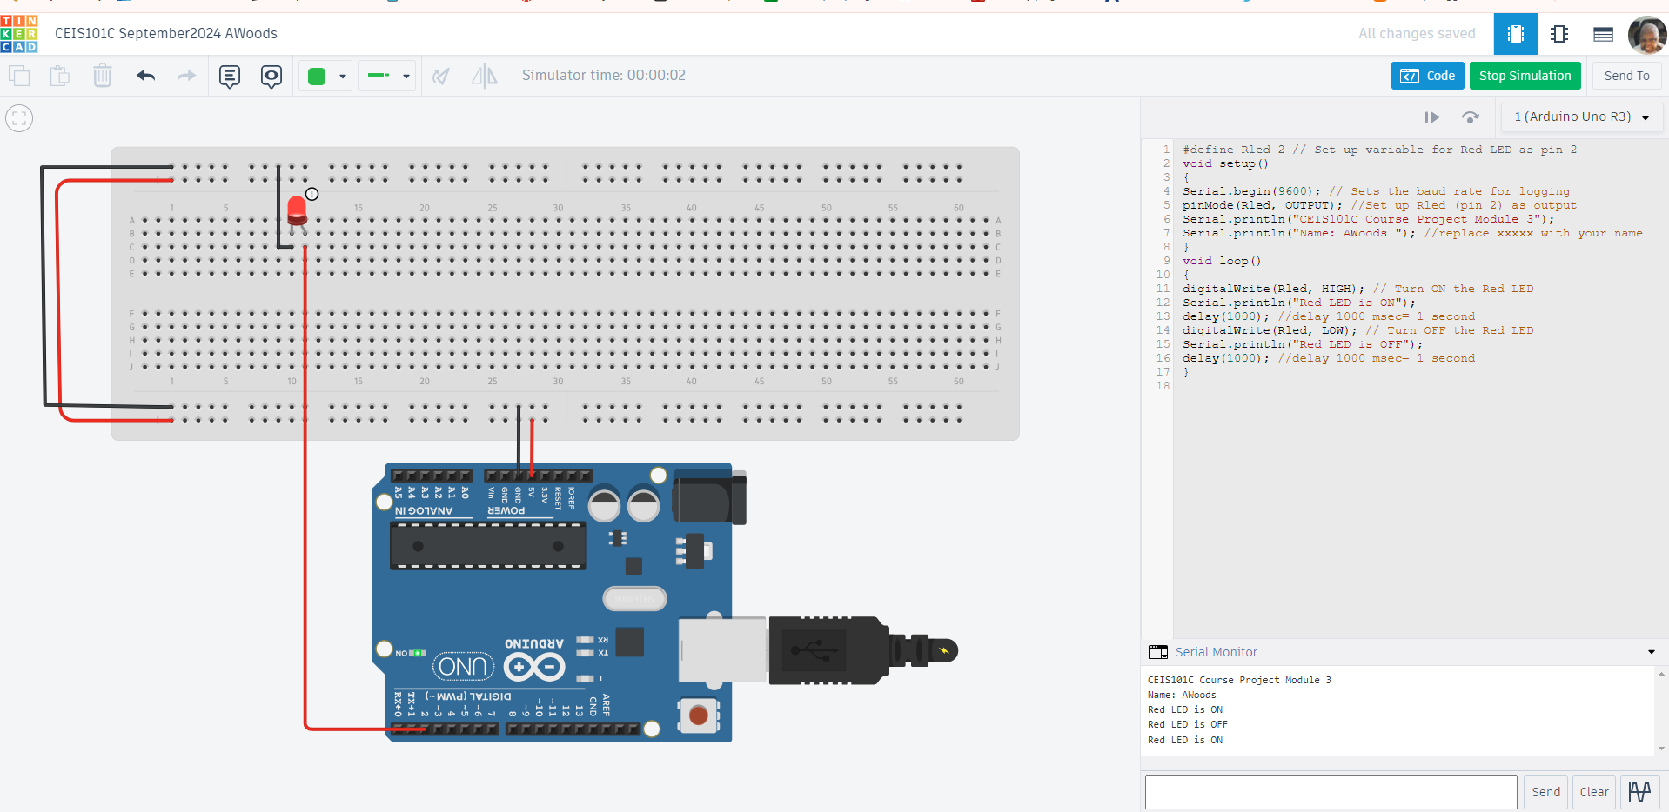
Serial Monitor (screenshot)

Slide 10
CEIS101
Module 4
Adding Door Sensor to Smart Home System

Slide 11
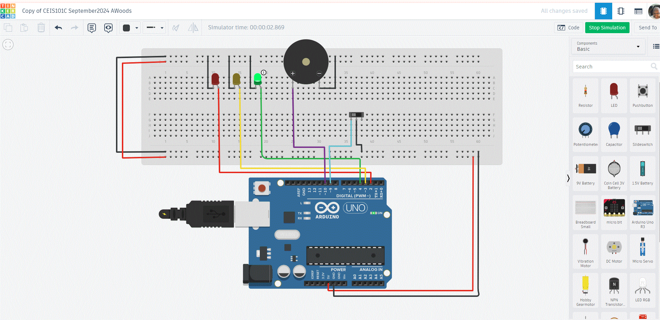
Circuit of door closed with Green LED ON (picture)

Slide 12
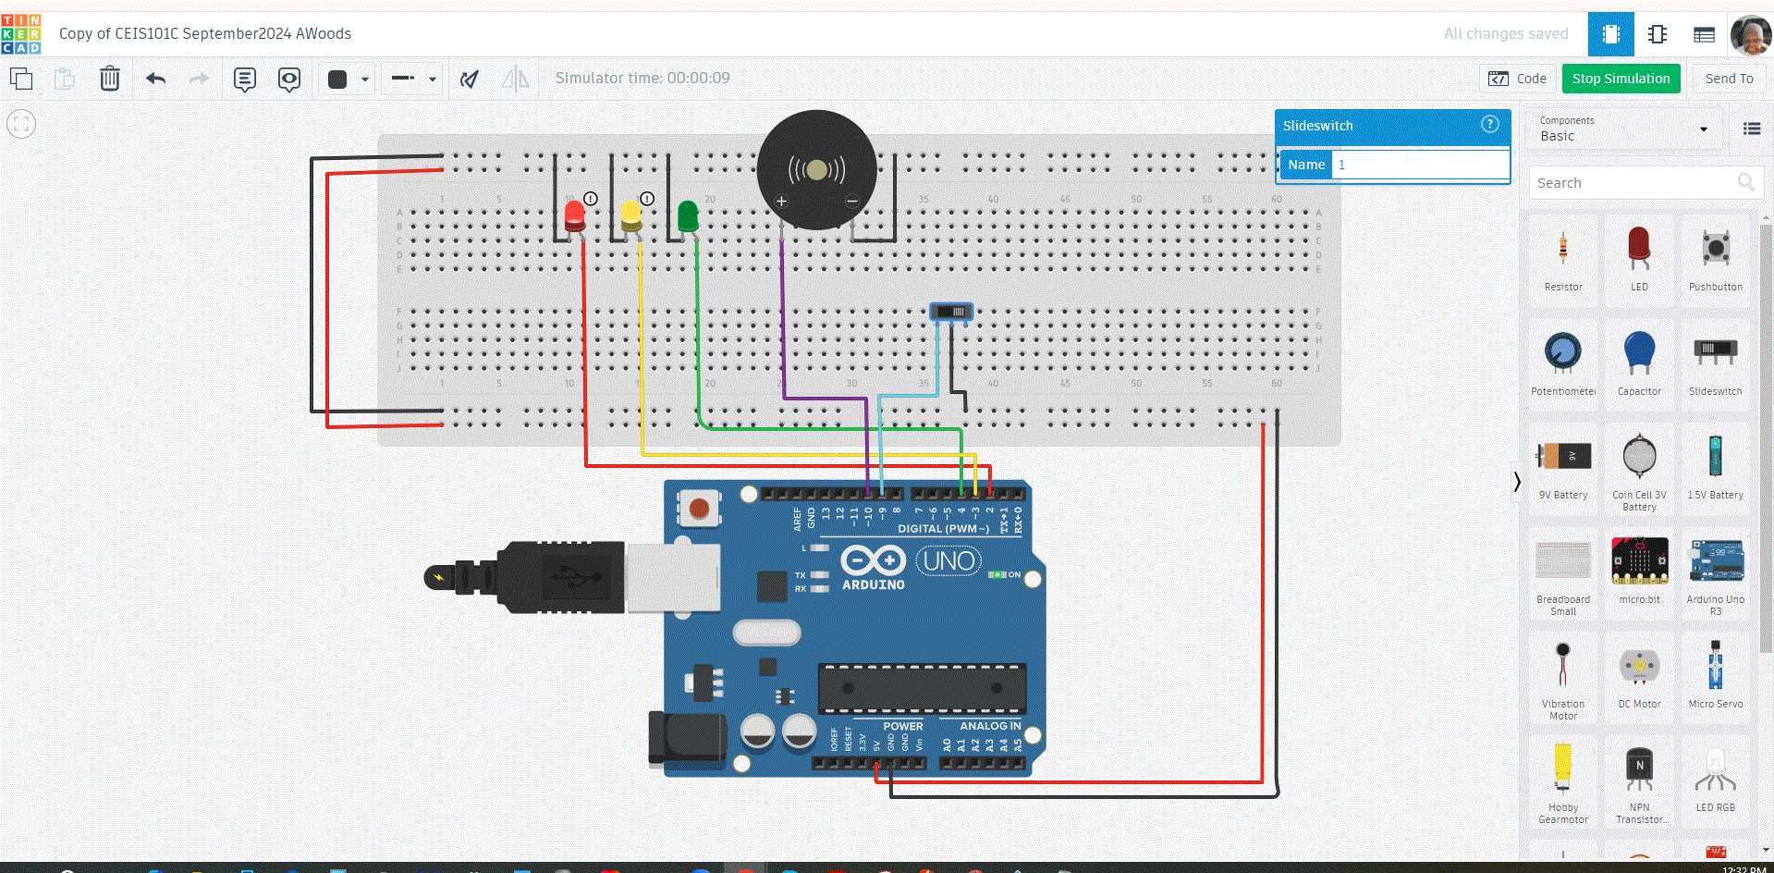
Circuit of door open with Green LED OFF (picture)

Slide 13
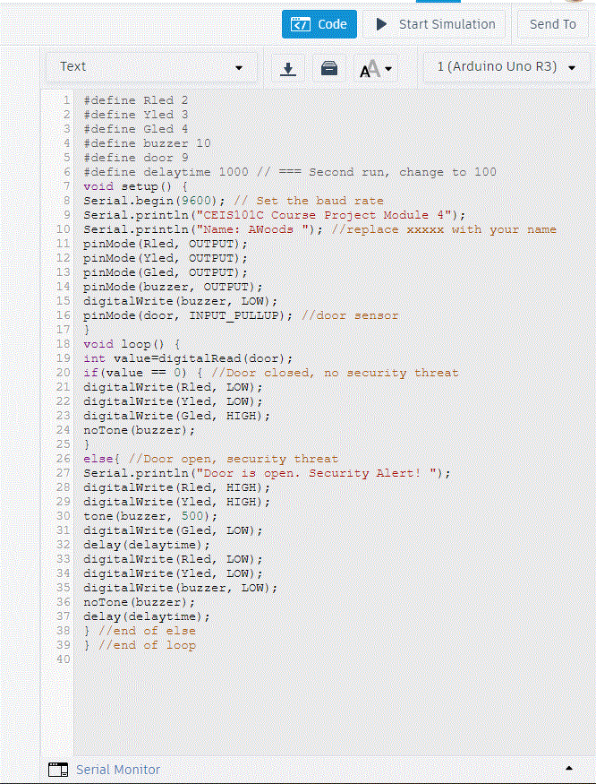
Arduino Code (screenshot)

Slide 14
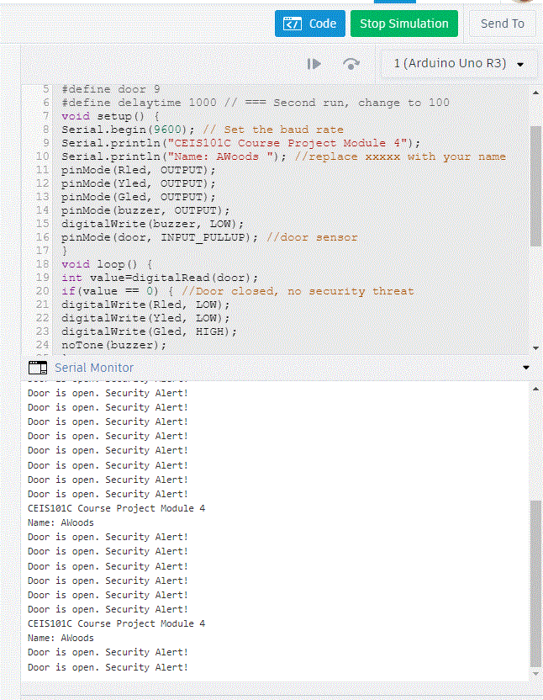
Serial Monitor (screenshot)

Slide 15
CEIS101
Module 5
Adding Distance Sensor to Smart Home System
and Conducting Data Analysis

Slide 16
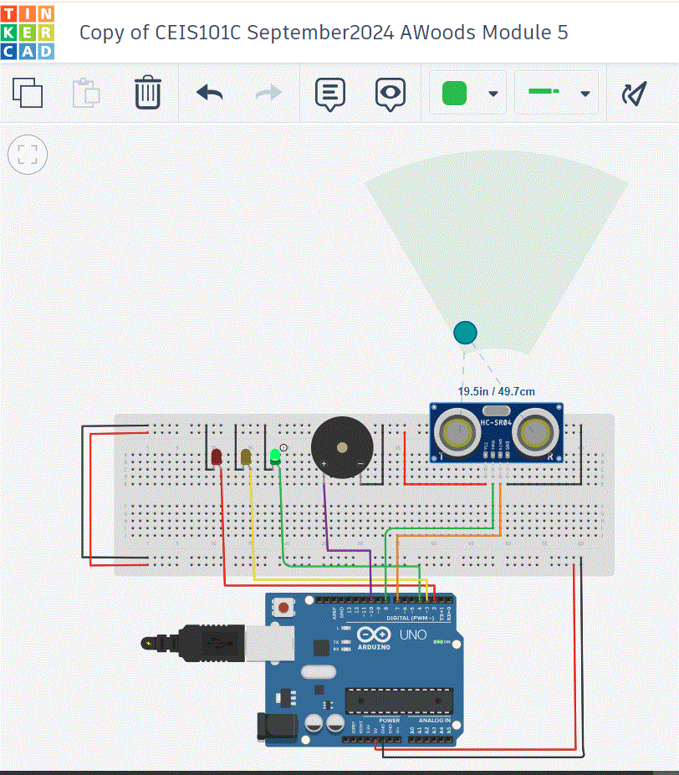
Circuit with green LED on (picture)

Slide 17
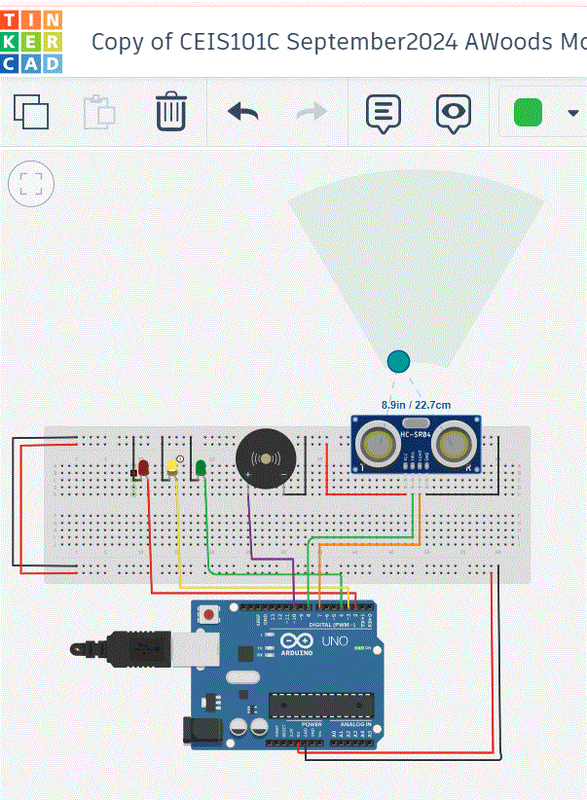
Circuit with yellow LED on (picture)

Slide 18
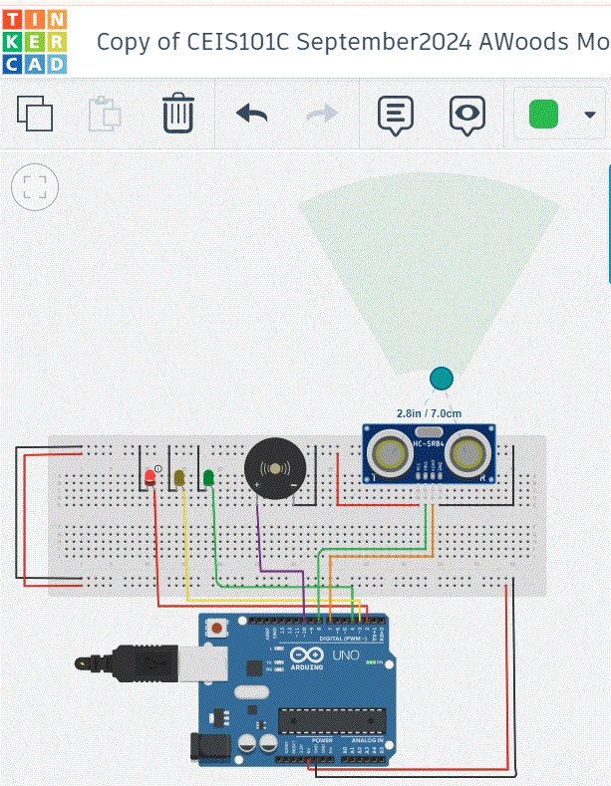
Circuit with red LED on (picture)

Slide 19
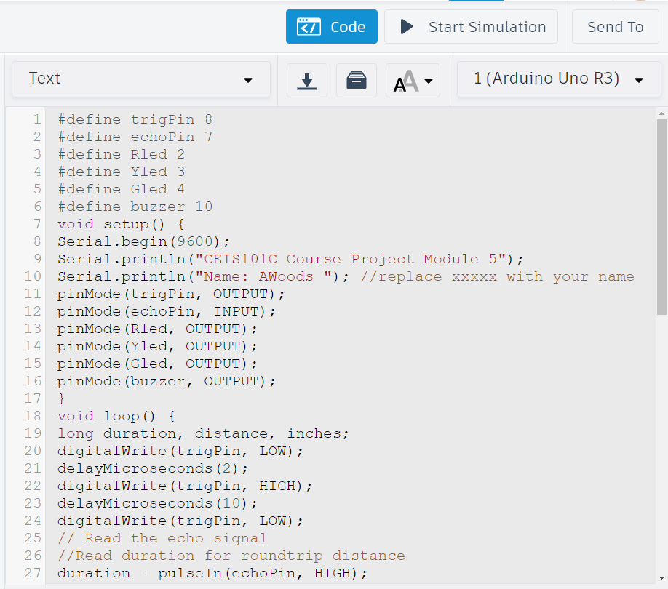
Arduino Code (screenshot)

Slide 20
Plot of data (graph from Excel)

Slide 21
CEIS101
Module 6
Adding Automated Light to Smart Home System

Slide 22
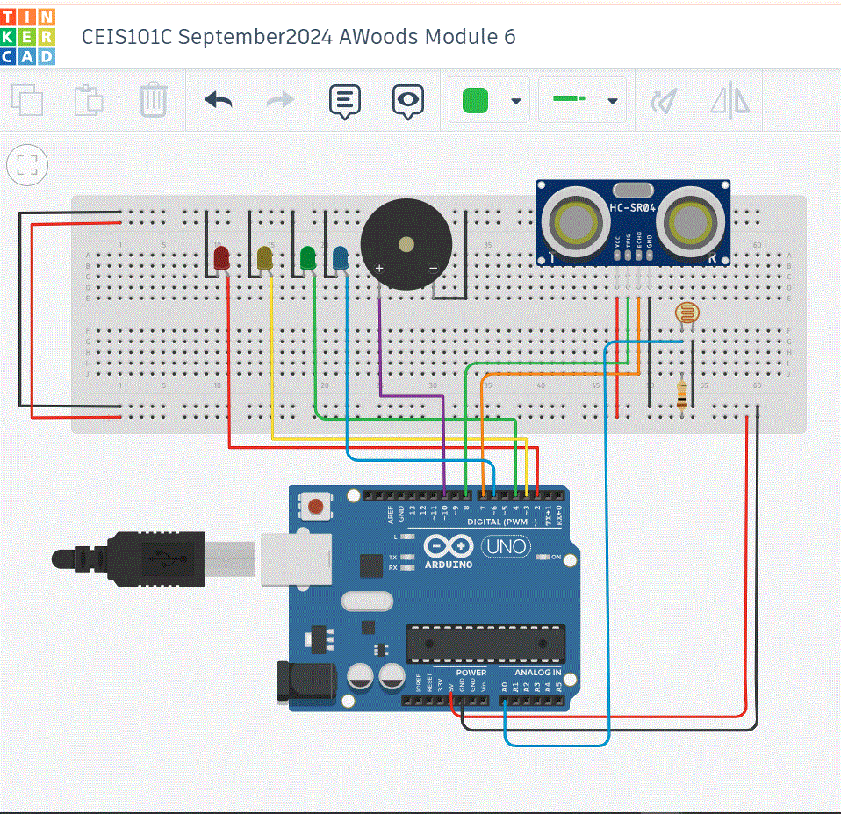
Circuit with automated LED off (picture)

Slide 23
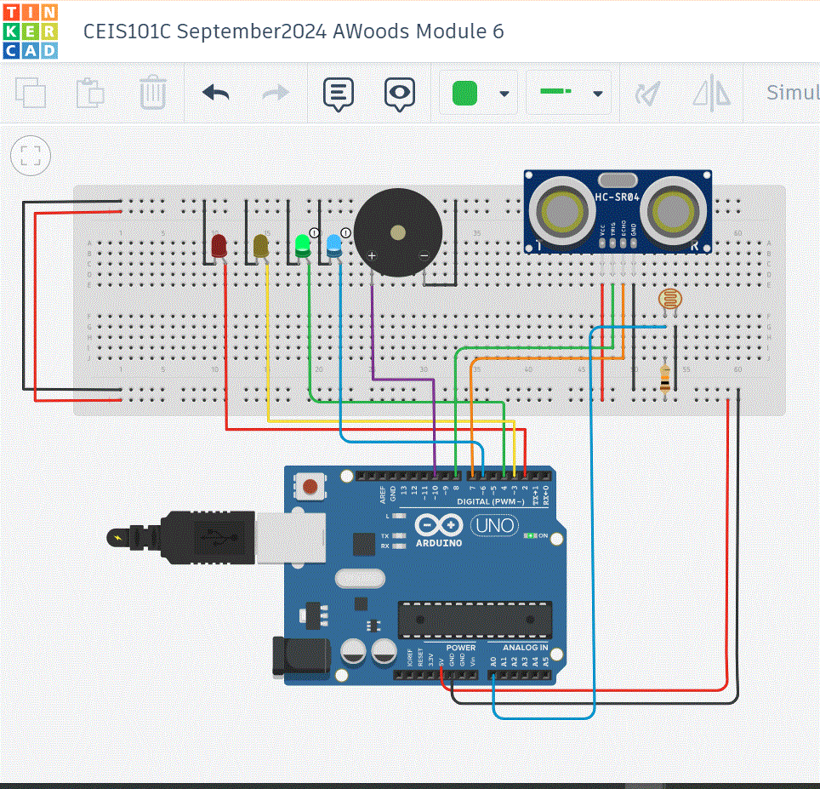
Circuit with automated LED on (picture)

Slide 24
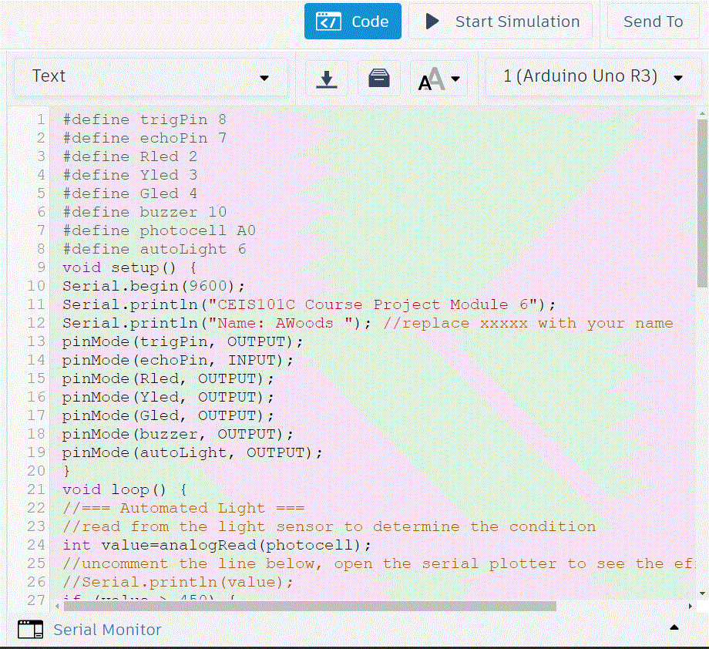
Arduino Code (screenshot)

Slide 25
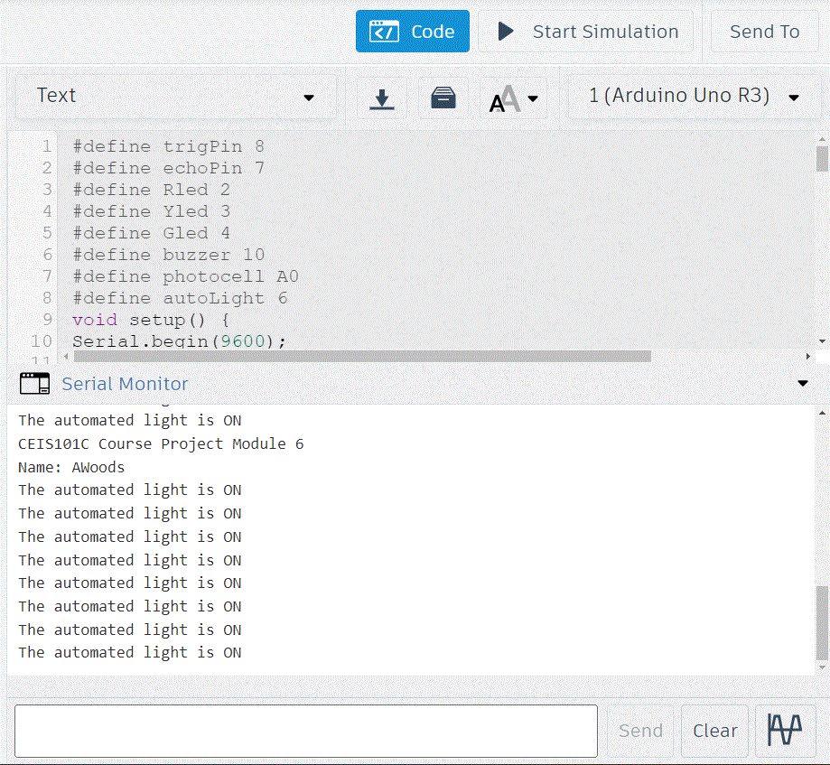
Serial Monitor (screenshot)

Slide 26
Challenges/Lessons Learned
The first obstacle I encountered when working on this project was feeling scared because it required information outside of my area of expertise. There was a little extra stress from having to complete other assignments and meeting deadlines. But as time went on, I developed a completely different perspective, and learning how to manage my time helped to make each day less stressful.
Lessons learn from this challenge not only enhanced my abilities in Tinkercad but also reinforced essentials skills for learning, creativity, and problem-solving in any future projects.

Slide 27
Career Skills
The skills that I developed that I know will benefit me in my career ar:
technical skills which will increase efficiency and expertise, making me a stronger candidate for advanced roles,
communication skills which are valued for their ability to convey complex information clearly, resolve conflicts and foster understanding,
Problem-solving and critical thinking which demonstrates adaptability and the ability to thrive in challenging situations, which can lead to roles that require strategic thinking and responsibility,
Time management and productivity skills that show that you can handle higher-level responsibilities without compromising quality, making me more appealing for promotion.

Slide 28
Conclusion
Navigating the journey of starting new projects, especially with tools like Tinkercad, brings challenges that, while daunting at first, are powerful opportunities for growth and skill development. Tackling issues like learning new interfaces, achieving precision, and overcoming setbacks teaches patience, adaptability, and problem-solving—competencies that are foundational for any career advancement.
Mastering technical skills, enhancing communication abilities, and developing emotional intelligence are crucial for those seeking greater career opportunities. When combined with critical thinking, time management, and the willingness to innovate, these competencies build a robust skillset that prepares you for complex, high-responsibility roles.
As you progress, remember that each challenge is not merely an obstacle but a stepping stone. By embracing learning moments and actively refining your abilities, you cultivate resilience and a competitive edge. Building a career with these principles ensures not only professional growth but also personal satisfaction as you contribute value and excel in a rapidly changing world. Stay adaptable, keep learning, and continuously strive to transform challenges into opportunities that propel you forward.

Slide 29
References used with this project:
Microsoft Office
PowerPoint
Tinkercad
Google Search

