Slide 1
Course Project
Operating Systems
Module 2 Linux Filesystem Hierarchy

Slide 2
Rubric
Activity | Requirement(s) | Points
Navigate the Linux filesystem tree | Answer two questions | 12
Create directories and files | Take a screenshot | 6
Copy and remove directories and files | Take a screenshot | 6
Locate directories and files | Take a screenshot | 6

Slide 3
Navigate the Linux filesystem tree
1. What is the pwd command an acronym for? What about the cd command?
Answer here:
pwd is an acronym fpr working directory”. It displays the current directory path you are in within a Linux -like operating system.
The command cd stands for “change directory”. This command is used to move between directories or folders in a Linux-like system.
2. Explain the differences between a relative path and an absolute/full path in Linux.
Answer here:
An absolute path specifies the location of a file or directory from the root directory
A relative path specifies the location of a file or directory based on the current directory.
References:
1.Project video
2.

Slide 4
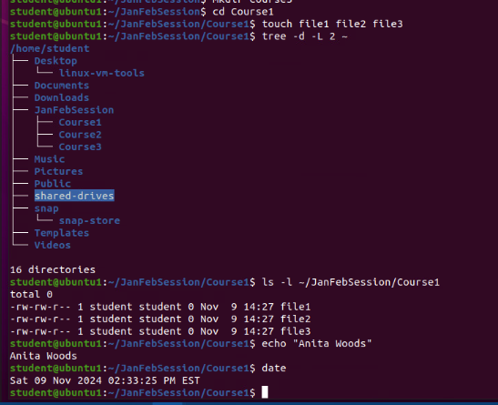
Create directories and files
Take a screenshot of the output in Steps 5 and 6.

Slide 5
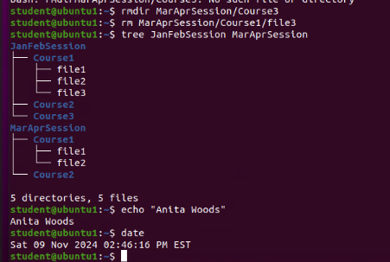
Copy and remove directories and files
Take a screenshot of the output in Step 3.

Slide 6
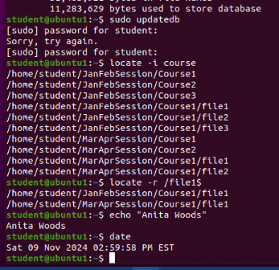
Locate directories and files
Take a screenshot of the output in Steps 5 and 6.

