Slide 1
CEIS298 Module 3
Create a new project using Microsoft Project 2019 and add tasks
Student Name: Anita Woods

Slide 2
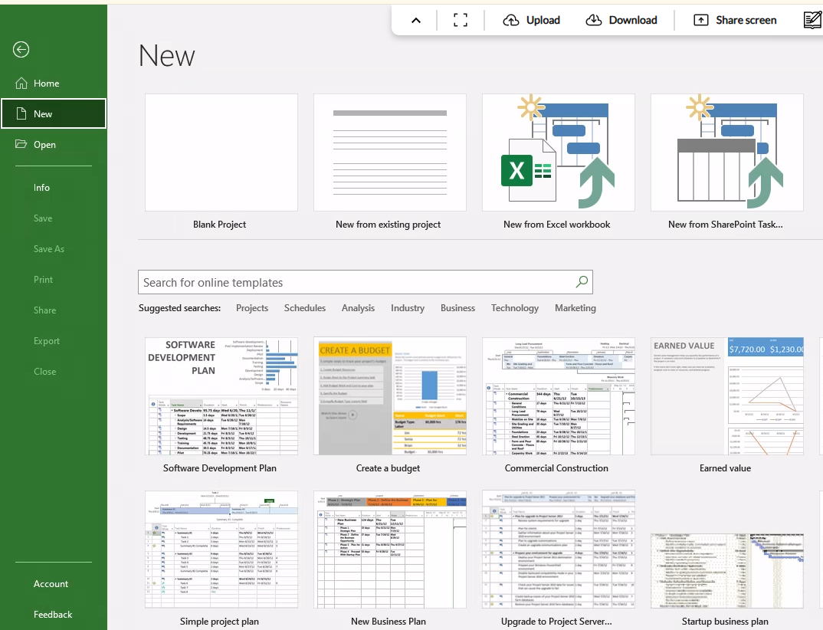
(Create a new project)

Slide 3
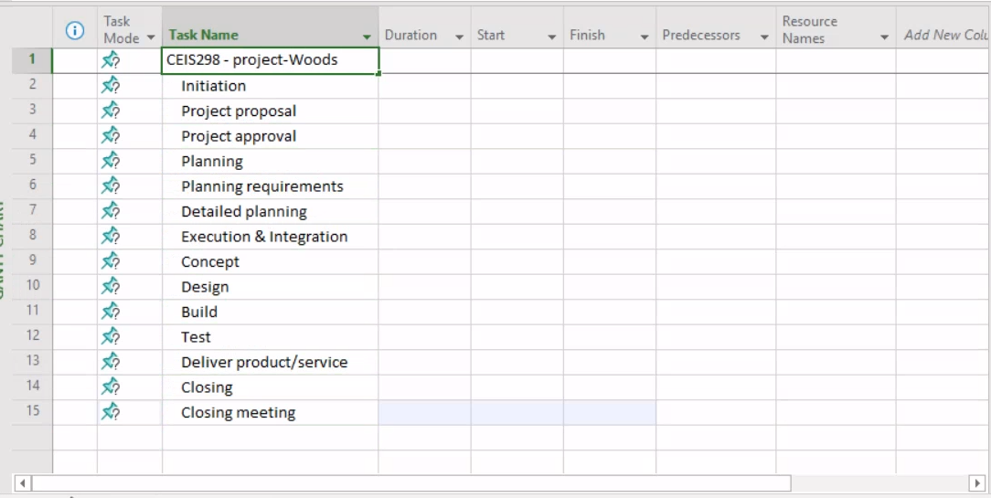
(Add tasks)

Slide 4
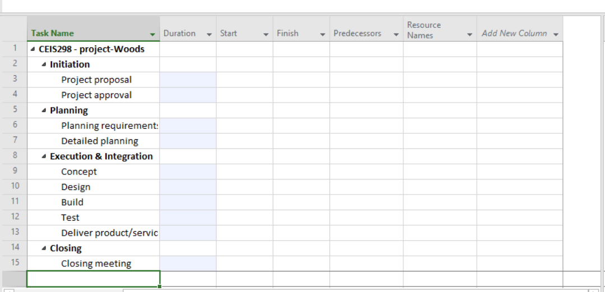
(Set dependencies)

Slide 5
(Set Duration for each task)

Slide 6
Question: How do you add a new task in Microsoft Project?
To add a new task in Microsoft Project
Open Microsoft Project
Once in the default view, click on the first empty row under the Task Name column.
Type the task name and press enter.

