Slide 1


Introduction to Operating Systems
CEIS106 Final Course Project
December 2024
Anita Woods
Instructor:
Allen Saylor

Slide 2

Agenda
Introduction
Operating Systems
  Module 2 Linux Filesystem Hierarchy
  Module 3 Linux Shell Scripts
  Module 4 User and Group Management
  Module 5 Network Configuration
  Module 6 System Performance Monitoring
Challenges
Career Skills
Conclusion

Slide 3
Introduction
Frequently, new applications and technologies are being developed. This is a continuous process. Because of this, a large number of new job opportunities are created, each of which requires the aforementioned skill set. As the employment market continues to evolve, it is essential to have a current knowledge of the skills that are required for it and to make the most of the numerous learning opportunities that are available.
A virtualized environment and the fundamentals of the Linux operating system are also things that are covered in this project. Examples of activities that fall under this category include traversing the Linux file system, developing shell scripts, and managing users. Together, gaining a grasp of IP setups and monitoring the performance of the system. In doing so, it lays the groundwork for your comprehension of developing technologies such as cloud computing and visualization. Consequently, you will be more prepared for a future profession in information technology.
Through the utilization of redirection and pipe meta characters, this course project will demonstrate how the Linux shell can be used to control command input and output.

Slide 4
Module 2
Linux Filesystem Hierarchy

Slide 5
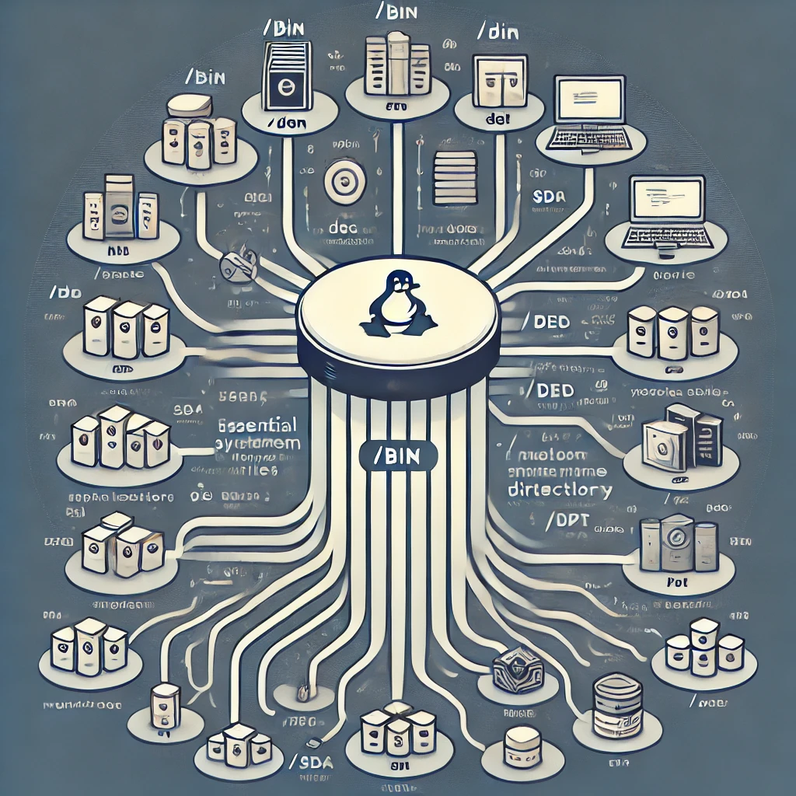
Linux Filesystem Hierarchy
Here is a visual representation of the Linux Filesystem Hierarchy. It illustrates the structure and purposes of the major directories in a clear, minimalist design.

Slide 6
Navigate the Linux filesystem tree
1. What is the pwd command an acronym for? What about the cd command?
Answer:
pwd is an acronym fpr working directory”. It displays the current directory path you are in within a Linux -like operating system.
The command cd stands for “change directory”. This command is used to move between directories or folders in a Linux-like system.
2. Explain the differences between a relative path and an absolute/full path in Linux.
Answer:
An absolute path specifies the location of a file or directory from the root directory
A relative path specifies the location of a file or directory based on the current directory.
Reference:
Project video

Slide 7
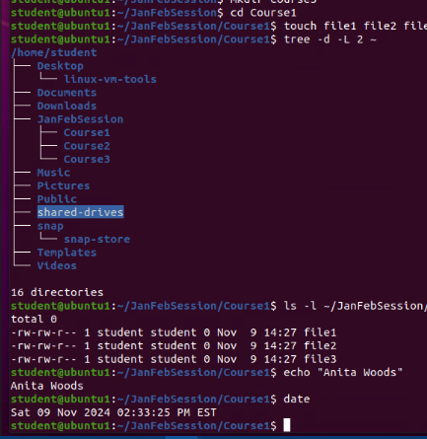
Create directories and files

Slide 8
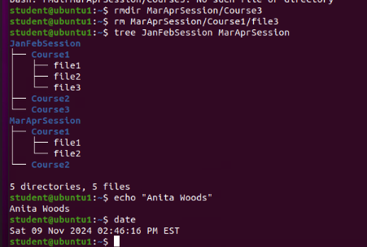
Copy and remove directories and files

Slide 9
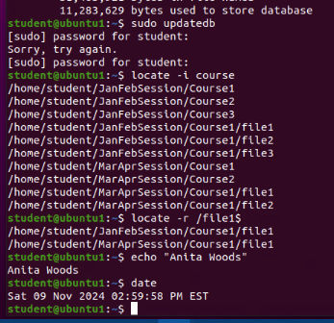
Locate directories and files

Slide 10

Module 3
Linux Shell Scripts

Slide 11

Create a shell script
1. What are the file permissions of the script?
Answer:
rw- rw- r- -read/write for the owner, read/write for the group, read only for everyone else
2. What’s the name of the user-defined variable in the script?
Answer:
text
3. Which redirection meta-character is used in the script? What does it do?
Answer:
>> - redirection to the file and appends to the end of the file
Reference:
  Project video

Slide 12
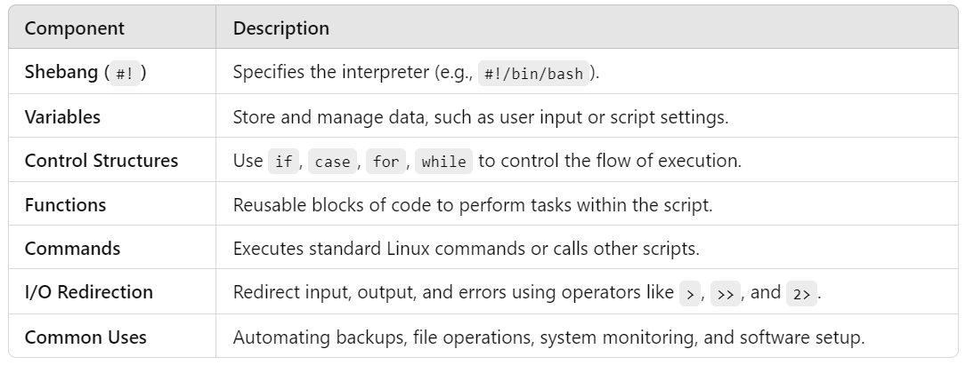
A Linux shell script is a text file containing a series of commands written for the shell to execute. Shell scripts automate repetitive tasks, manage system configurations, and perform complex operations by combining multiple commands into a single, executable file.
Key Features of Shell Scripts

Slide 13
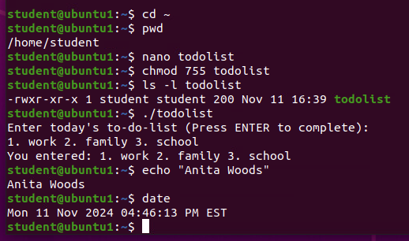
Change script file permissions

Slide 14
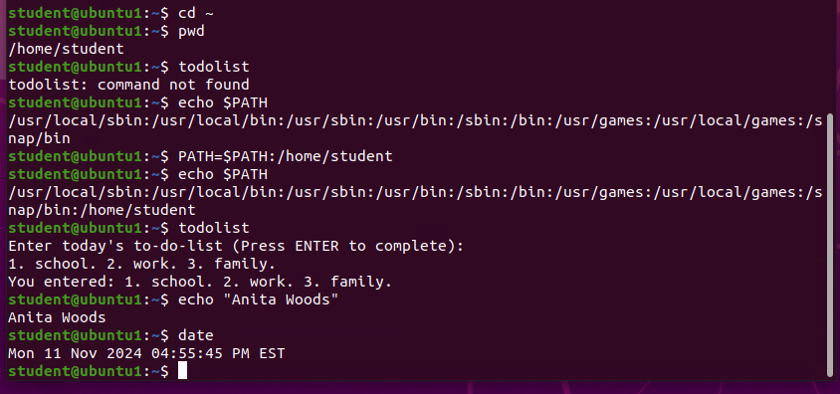
Set the Path variable

Slide 15
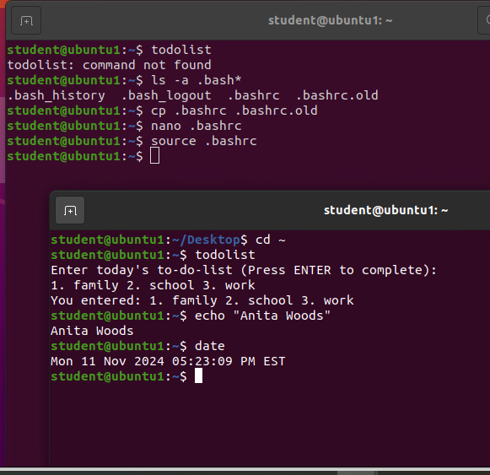
Make the PATH variable permanent

Slide 16

Module 4
User and Group Management

Slide 17

Add users and groups in CLI
1. What does the –m option in the useradd command do?
Answer:
-m –tells useradd command to create a home directory for this new user
2. What does the -3 option in the tail command do?
Answer:
-3 – tells tail command how many lines to show from the end of the file
3. Which line of the /etc/group file lists members of the “students” group?
Reference:
Project video
Answer:

Slide 18
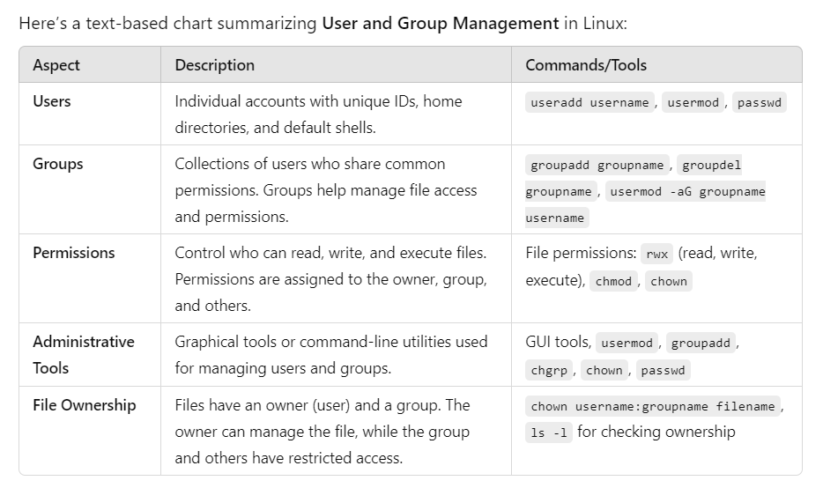
User and group management in Linux involves creating, modifying, and managing users and groups to control system access and organize permissions efficiently.

Slide 19
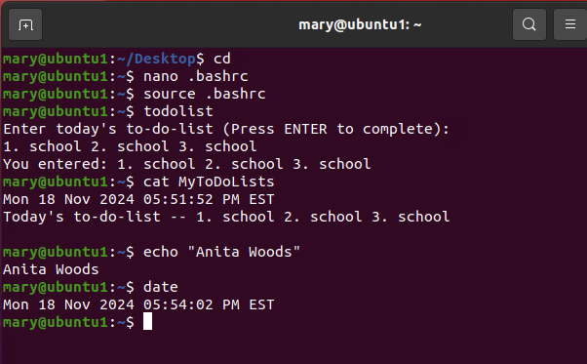
Test user and group settings

Slide 20
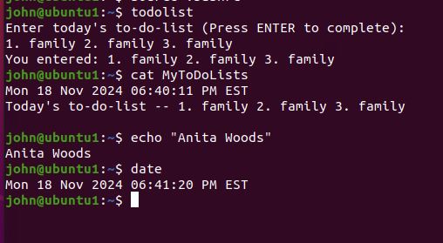
Add users in GUI

Slide 21
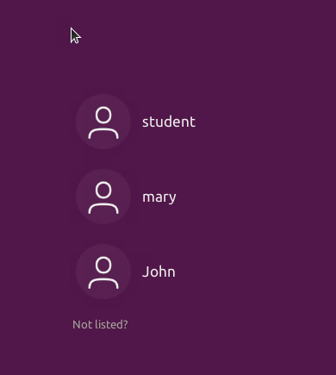
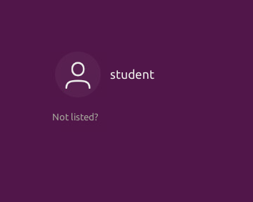
Remove users and groups

Slide 22

Module 5
Network Configuration

Slide 23
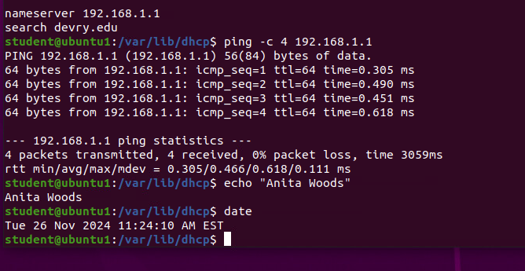
Discover host IP configurations
1. What is the IP address of your Ubuntu machine?
Answer:
192.168.1.107
2. What is the IP address of its default gateway?
Answer:
192.168.1.1
3. What is the IP address of its DHCP server?
Answer:
192.168.1.1
4. What is the IP address of its DNS server?
Answer:
192.168.1.1

Slide 24

Manage network interfaces
Which DHCP message is shown in the output of the sudo dhclient –v –r eth0 command?
Answer:
DHCPRELEASE
Which four DHCP messages are shown in
the output of the sudo dhclient –v eth0
command?
Answer:
DHCPDISCOVER
DCHPOFFER
DCHPREQUEST
DCHPACK

Slide 25
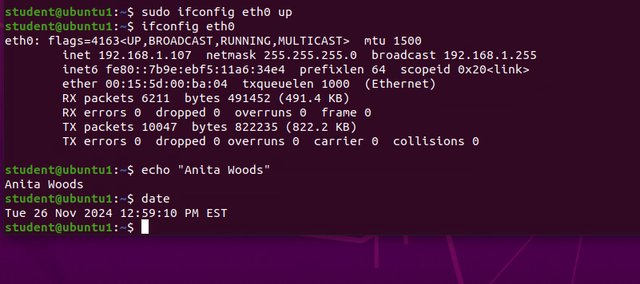
Use network utilities

Slide 26
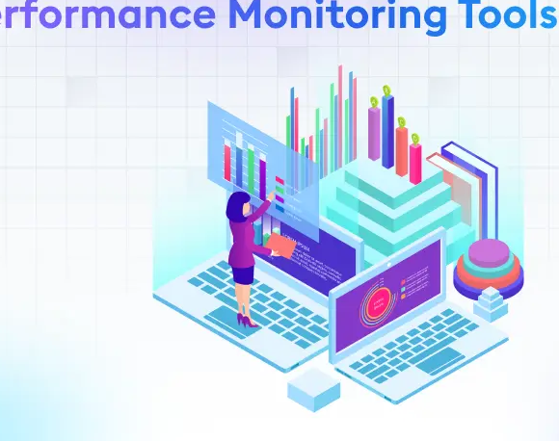
Module 6
System Performance Monitoring

Slide 27
Monitor Linux processes
1. What is the default action of the 15 SIGTERM kill signal?
Answer:
Kill the highlighted process
2. In the System Monitor window, click on % CPU to sort the processes by CPU load. Which process shows the highest percentage of CPU usage?
Answer:
Gnome-shell (GUI)
Reference:
Project Assistance video

Slide 28
Monitor user activities
Issue the sudo accton on command to turn on GNC accounting. Run the sudo updatedb command. Enter lastcomm updatedb to check if the updatedb command was executed before. Remember to turn off GNC accounting (sudo accton off) after answering the questions.
1. What flag value is displayed in the output?
Answer:
s – ”super user”
2. Why is the name of the user who ran the processes shown as root, not student?
Answer:
Superuser – since we typed sudo in front of the command.
Reference:
Project Assistance video

Slide 29
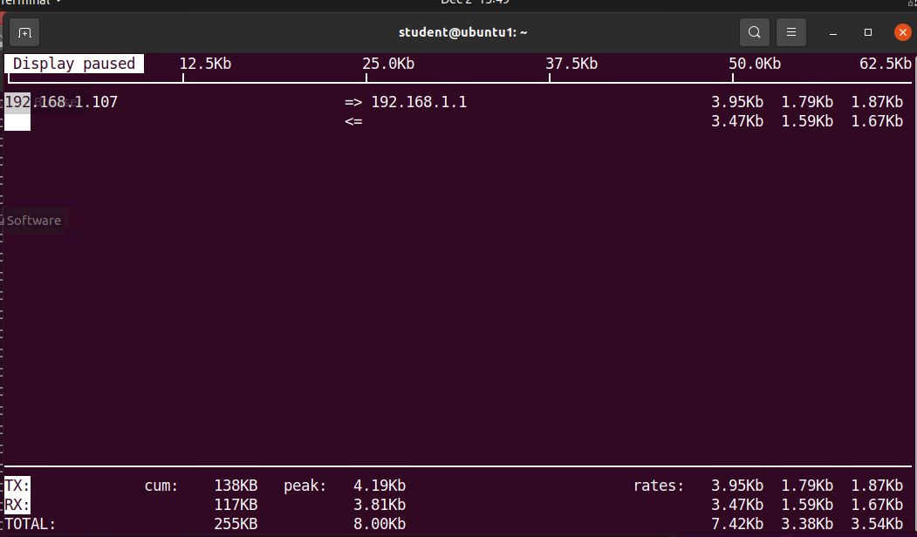
Monitor network bandwidth usage

Slide 30
Challenges
The first obstacle I encountered when working on this project was feeling scared because it required information outside of my area of expertise. There was a little extra stress from having to complete other assignments and meeting deadlines. But as time went on, I developed a completely different perspective, and learning how to manage my time helped to make each day less stressful.
Lessons learn from this challenge reinforced essential skills for learning, creativity, and problem-solving in any future projects.

Slide 31
Career Skills
The skills that I developed that I know will benefit me in my career are:
Technical skills which will increase efficiency and expertise, making me a stronger candidate for advanced roles,
Communication skills which are valued for their ability to convey complex information clearly, resolve conflicts and foster understanding,
Problem-solving and critical thinking which demonstrates adaptability and the ability to thrive in challenging situations, which can lead to roles that require strategic thinking and responsibility,
Time management and productivity skills that show that you can handle higher-level responsibilities without compromising quality, making me more appealing for promotion.

Slide 32
Conclusion
Navigating the journey of starting new projects, brings challenges, while daunting at first, are powerful opportunities for growth and skill development. Tackling issues like learning new interfaces, achieving precision, and overcoming setbacks teaches patience, adaptability, and problem-solving—competencies that are foundational for any career advancement.
Mastering technical skills, enhancing communication abilities, and developing emotional intelligence are crucial for those seeking greater career opportunities. When combined with critical thinking, time management, and the willingness to innovate, these competencies build a robust skillset that prepares you for complex, high-responsibility roles.
As you progress, remember that each challenge is not merely an obstacle but a stepping stone. By embracing learning moments and actively refining your abilities, you cultivate resilience and a competitive edge. Building a career with these principles ensures not only professional growth but also personal satisfaction as you contribute value and excel in a rapidly changing world. Stay adaptable, keep learning, and continuously strive to transform challenges into opportunities that propel you forward.

Slide 33
References used with this project:
Microsoft Office
PowerPoint
Google Search
AI Playground
Project Videos

Slide 34
Thank you
Anita Woods
DeVry University

